Slide 1
JOINTS

Slide 2
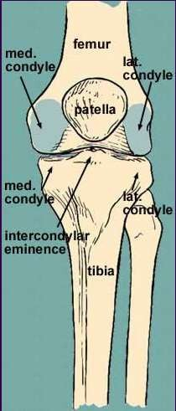
Introduction of Joints
Dr. Vibhash Kumar
◆ Joint is a junction between two or more bones or cartilages. It is a device to permit movement.
◆  There are 230 joints in the body

Slide 3
Functions of joint
Dr. Vibhash Kumar
◆ Hold the skeletal bones together.
◆ Allow the skeleton some flexibility so gross movement can occur.
◆ Make bone growth possible.

Slide 4
Classification of joints
Dr. Vibhash Kumar
◆ Joint are classified into 2 types on the basis of presence or absence of joint cavity.
synarthroses( without joint cavity)- further divided into
  Fibrous joint
  Cartilagenous joint
  2. Diarthroses ( synovial joints): mobile with synovial joint cavity.

Slide 5
Structural Classification of Joints
Dr. Vibhash Kumar
Fibrous (Fixed)
A. Sutures
Plane
Squamous
Serrate
Dentate
Schindylesis
B. Gomphosis
C. Syndesmosis
Cartilaginous (Slightly movable)
A. Primary Cartilaginous joints (Synchondrosis)
Synovial
Freelymovable)
Plane
Hinge
Pivot
Bicondylar
Ellipsoid
Saddle
Ball and socket
B. Secondary Cartilaginous joints (Symphysis)

Slide 6
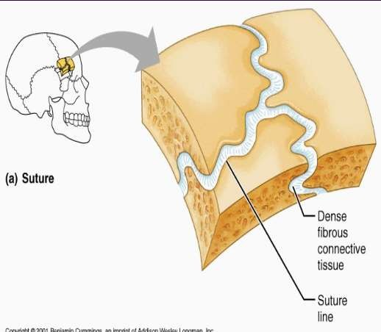
Structural classification cont…
Dr. Vibhash Kumar
Fibrous Joints :- Bones are joined by fibrous tissue/dense connective tissue, consisting mainly of collagen. The fibrous joints are further divided into three types:-
1. Sutures :- fibrous connective tissue connects the bones without allowing movements. Found between bones of the skull).

Slide 7
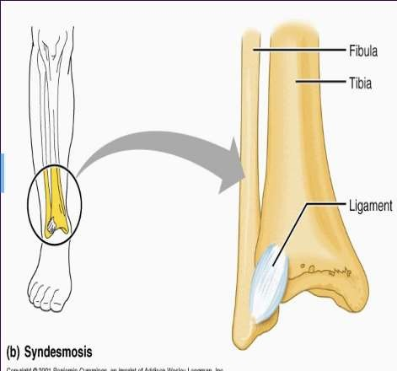
Dr. Vibhash Kumar
◆ 2. Syndesmoses are joints where two adjacent bones are join together by a greater amount of connective tissue.
◆ Eg-interosseous radioulanr joint,inter osseous tibio fibular joint.

Slide 8
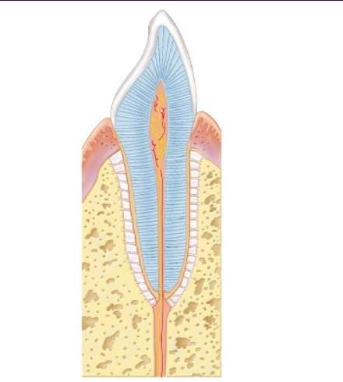
Dr. Vibhash Kumar
◆ 3. Gomphoses(peg and socket) :- It is a specialized fibrous joint restricted to fixation of teeth in alveolar sockets ofthe maxilla or mandible..

Slide 9
CARTILAGINOUS JOINTS
Dr. Vibhash Kumar
◆ In this type of joint the bones are joined by cartilage.
◆ There are two types of cartilaginous joints:
Primary cartilaginous joints
Secondary cartilaginous joints

Slide 10
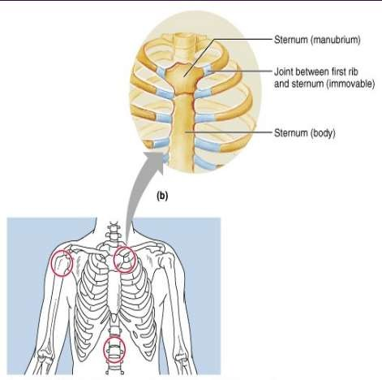
1. Primary cartilaginous joints
Dr. Vibhash Kumar
◆ joints - Known as "synchondroses".
Bones forming joints are connected by a plate of hyaline cartilage. These joints are immovable.
◆ Examples in humans are the joint between the first rib and the manubrium of the sternum
◆ Joint between epiphysis and diaphysis of growing long bone.

Slide 11
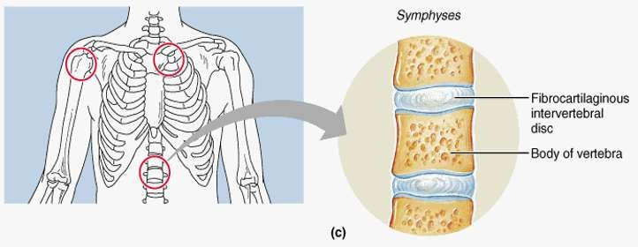
2. Secondary cartilaginous joints
Dr. Vibhash Kumar
◆ Known as "symphysis". In these joints the
articular surfaces of bone forming the joints are covered by thin plates of hyaline cartilage,which are connected by a disc of fibrocartilage.
◆ Example:-symphysis pubis
◆ Intervertebral disc
◆

Slide 12
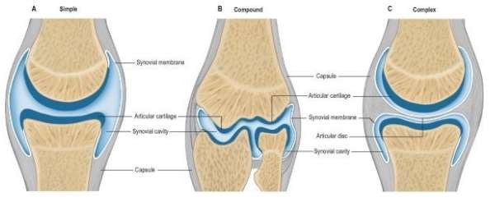
SYNOVIAL JOINTS
Dr. Vibhash Kumar
◆ These joints possess a cavity and the articular ends of bones forming the joint are enclosed in a fibrous capsule.As a result they are seprated by a narrow cavity,the articular cavity,which is filled with a fluid called synovial flud.

Slide 13
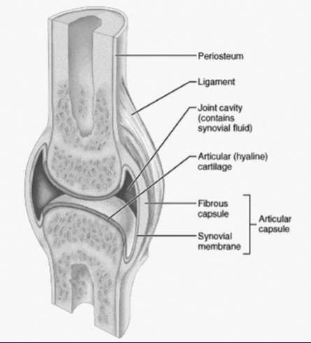
Characteristic features
Dr. Vibhash Kumar
◆ The articular surfaces are covered by a thin plate of hyaline cartilage.
◆ The cavity of joint is lined everywhere by synovial membrane except over articular cartilages.
◆ The cavity is filled with synovial fluid secreted by synovial membrane which provides nutrition to articular cartilage and lubrication of articular surfaces.
◆ .

Slide 14
Types of synovial joints
Dr. Vibhash Kumar
◆ Plane Joint
◆ Hinge Joint
◆ Pivot Joint
◆ Condylar Joint
◆ Ellipsoid joint
◆ Saddle Joint
◆ Ball-and-Socket Joint

Slide 15
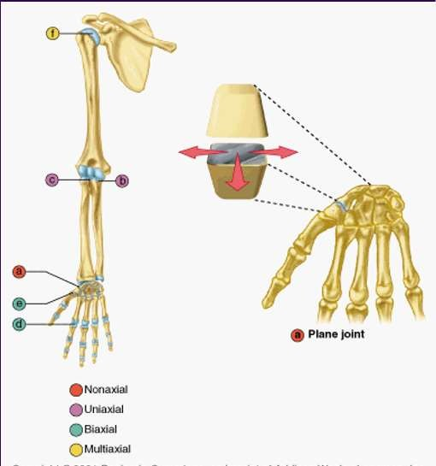
Plane Joint
Dr. Vibhash Kumar
◆ Articular surfaces are more or less flat.
◆ They permit gliding movements in various directions.
◆ Examples; intercarpal joints,intertarsal joints.

Slide 16
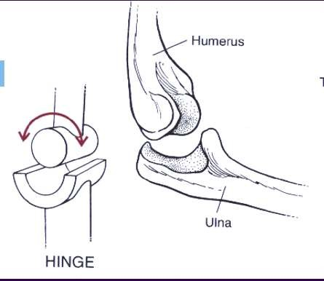
Hinge Joint
Dr. Vibhash Kumar
◆ Hinge Joint: the articular surface are pulley shaped.This movement consists of flexion and extension.
◆ Two examples are the elbow joint, knee joint, interphalangeal joint ,ankle joint.

Slide 17
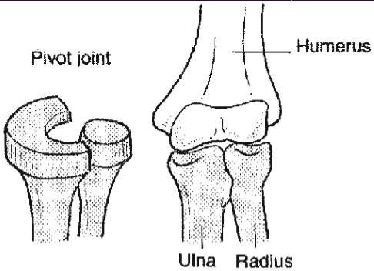
Pivot Joint
Dr. Vibhash Kumar
◆ The articular surface of one bone is rounded and fits into concavity of another bone.further,rounded part is surrounded by a ligamentous ring.
◆ Movement is limited to the rotation around a central axis.
◆ Examples of this type of joint are the joints between the proximal ends of the radius and ulna, and atlanto axial joint.

Slide 18
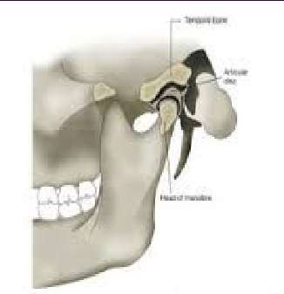
Condylar Joint
Dr. Vibhash Kumar
◆ The round articular surface of one bone fits into socket type articular surfae of another bone.
◆ The end of bone bearing round articular surface is called condyle .these joint permit movements in 2 direction.
◆ Examples – right and left temporo mandibular joints.
knee joint

Slide 19
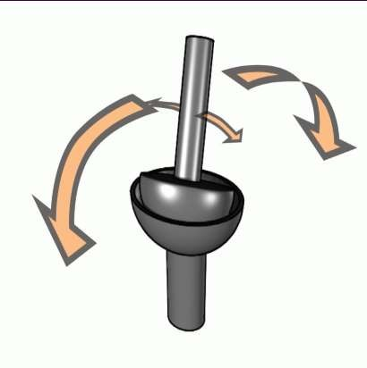
Ellipsoid joint
Dr. Vibhash Kumar
◆ Elliptical convex surface of one bone articulates with elliptical concave surface of another bone.
◆ The movements are permitted in two directions. Flexion extension or abduction adduction
◆ Eg; wrist joint , atlanto occipital joint,metacarpo phalangeal joints,metatarso phalangeal joint

Slide 20
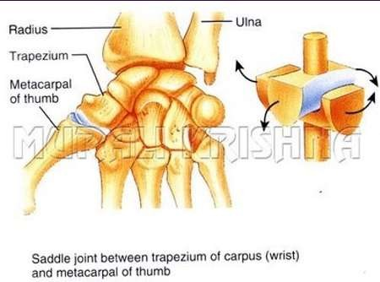
Saddle Joint
Dr. Vibhash Kumar
◆ Saddle Joint: The articular surfaces are reciprocally saddle shaped i.e
.concavo -convex.this unique artiulation is modified condyloid joint that allows a wide range of movement.
◆ eg; carpometacarpal joint of thumb.

Slide 21
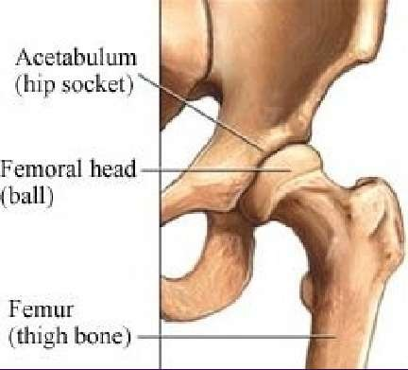
Ball-and-Socket Joint
Dr. Vibhash Kumar
◆ Ball-and-Socket Joint: consists of a bone with a ball-shaped head that attaches with the cup-shaped cavity of another bone.
◆ This type of joint allows for a wider range of motion than any other kind.
◆ It permits movement in all planes, and a
rotational movement around a central axis.
◆ Two examples of this type of joint would be the hip, shoulder joints and incudostapedial joint.

Slide 22
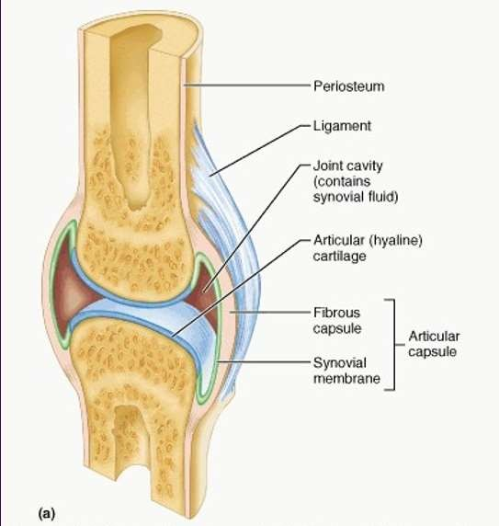
STRUCTURE OF SYNOVIAL JOINT
Dr. Vibhash Kumar
◆ A). fibrous Capsule
◆ B). Reinforcing Ligaments
◆ C). Synovial membrane
◆ D). Articular Cartilage
◆ E). Articular Discs
◆ F). Fatty Pads
◆ G). Bursae Flattened sacs that contain synovial fluid. Function to reduce friction

Slide 23




Dr. Vibhash Kumar

