Slide 1
NEURON

Slide 2
The Nervous System
The nervous system coordinates all body functions, enabling a person to adapt to changes in internal and external environment
The nervous system is composed mainly of the nerve cells (neurons) and supporting cells (neuroglial cells)

Slide 3
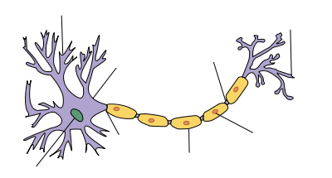
The NEURON
The nervous system is composed of neurons, which produce and conduct electrochemical impulses and supporting cells, which assist the functions of neurons.

Slide 6
The neuron
This is the basic conducting cell of the nervous system. Highly specialized but cannot reproduce itself
Main parts
Cell body
Axon
Dendrites.

Slide 7
1. Cell body
Cytoplasm of cell body is covered by cell membrane with centrally placed nucleus
Cytoplasm contain mitochondria, golgi apparatus, ribosomes and lysosomes
Cytoplasm contains a granular material called Nissl substances, composed of RER
Neurofibrils are also present
Cytoplasmic processes are axons and dendrites

Slide 8
2. Axon
The axon is a long cytoplasmic extension from the cell body.
Axon is a long process with myelin sheath. This conducts impulses away from the cell body.
Term nerve fiber is used for this
Side branches called collateral branches

Slide 9
Dendrites
The dendrites are short, thick, diffuse branching processes that extend from cell body.
function is to receive impulses and conduct them towards the cell body.
Some dendrites contain minute spines to increase surface area
It contain nissl substances which absent in axon

Slide 10
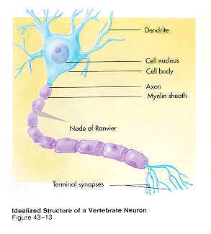

Slide 11
Neuron - types
According to no of cytoplasmic processes
Unipolar/pseudo unipolar
Bipolar
Multipolar
According to length of axons
Golgi type I : Long axon
Golgi type II : Short axon
[refer page no 49 fig 8.3)

Slide 12
The neuroglia
These are the supporting cells of the nervous tissue.
They are more numerous than neurons
They supply nutrients to the neurons and help maintain the electrical potential.

Slide 13
Neuroglia - Types
Astrocytes : blood brain barrier
Oligodendrocytes: form myelin sheath in CNS
Microglial cells : perivascular coat of blood vessel in CNS, It is phagocytic
Ependyma : ventricles of brain and central canal of spinal cord
Schwann cells : Forms myelin sheath in PNS

Slide 14
Nerve
Collection of cytoplasmic processes of neurons.

Slide 15
SYNAPSE
Junction between the neurons
Types
Axo dendritic synapse : between axon and dendrite
Axo somatic synapse: axon and cell body
Axo axonal synapse: axon of one neuron and axon of another neuron.
Dendro dendritic:dendrite of one neuron and dendrite of another rneuron.

Slide 16
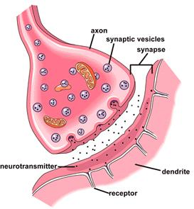

Slide 17
Neurotransmitters.
Impulses are transmitted across a synapse by neurotransmitters : acetylcholine, dopamine, serotonin, histamine, GABA, glycine

Slide 18
Grey and white matter
Sections through brain and spinal cord show whitish and dark greyish areas.
They are called white matter and grey matter respectively.
The white matter contains predominantly myelinated fibers.

